Slide 1
PRIMETIME
Sean Blanchard & Ferid Ruano

Slide 2
Overview
We chose to develop our program in C using OpenMP
The program’s objective is to find two prime factors of a given composite
The given composite is required to be a multiple of two primes
Using ‘unsigned long long int’ we can compute at least a 2⁶⁴ composite
The master thread determines whether the composite itself is 4, 6, 9 or a multiple of 2 or 3. The remaining threads utilize a base 6 matrix to determine the prime factors, if needed.

Slide 3
Base 6 Prime Pattern
A prime number is divisible by 1 and itself.
A pattern can be found using a Base 6 matrix
With the exception of 2 and 3 every prime number exists within column 1 and 5.
The pattern for column 1 is ‘6n + 1’
The pattern for column 5 is ‘6n - 1’
Source: Prime forms
1 | 2 | 3 | 4 | 5 | 6
7 | 8 | 9 | 10 | 11 | 12
13 | 14 | 15 | 16 | 17 | 18
19 | 20 | 21 | 22 | 23 | 24
25 | 26 | 27 | 28 | 29 | 30
31 | 32 | 33 | 34 | 35 | 36
37 | 38 | 39 | 40 | 41 | 42

Slide 4
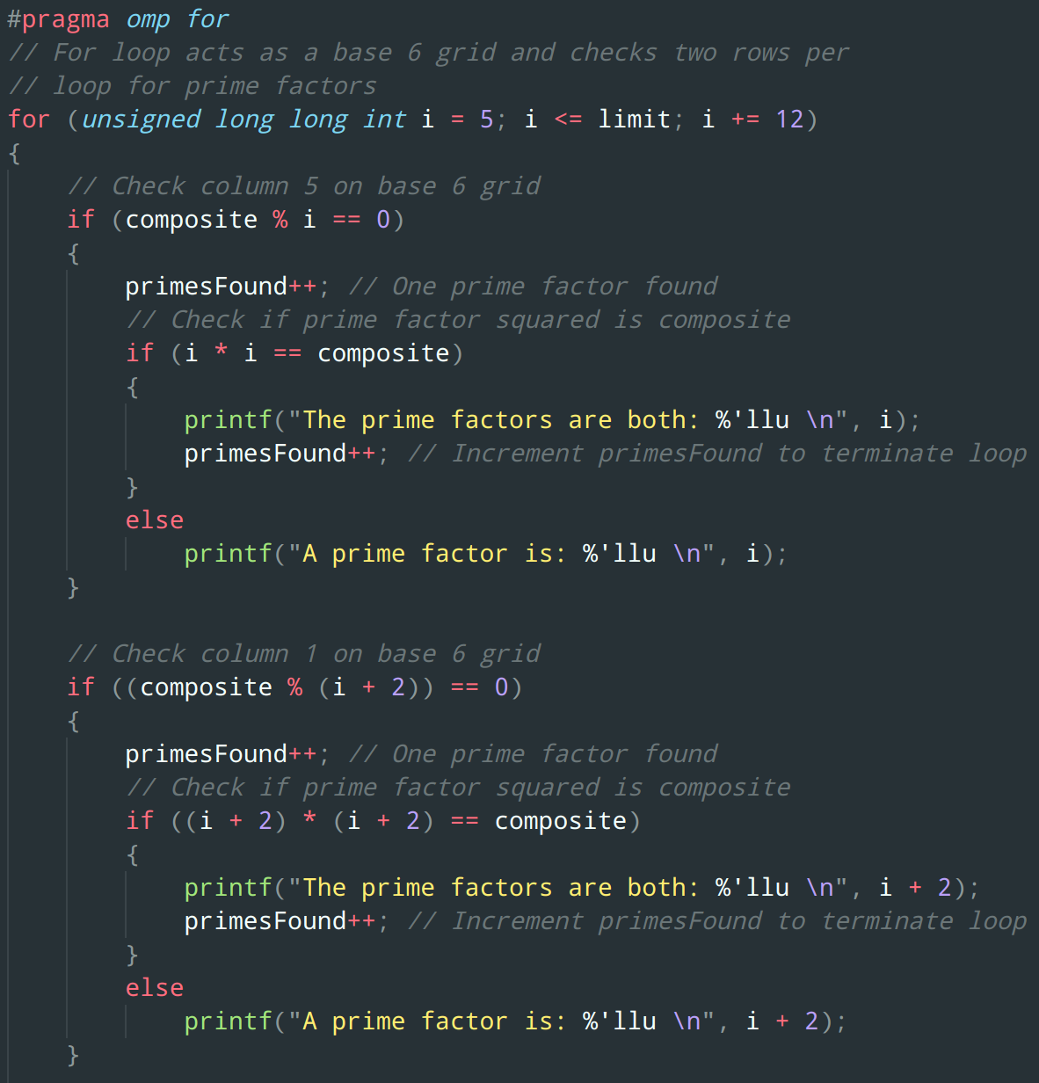
Our Code
The for loop acts as a Base 6 matrix iterator
One loop checks two rows for prime factors
i, i + 2, i + 6, i + 8
There is a check for a composite of a squared prime factor
When two primes factors are found the for loop terminates by making i > limit

